Slide 1
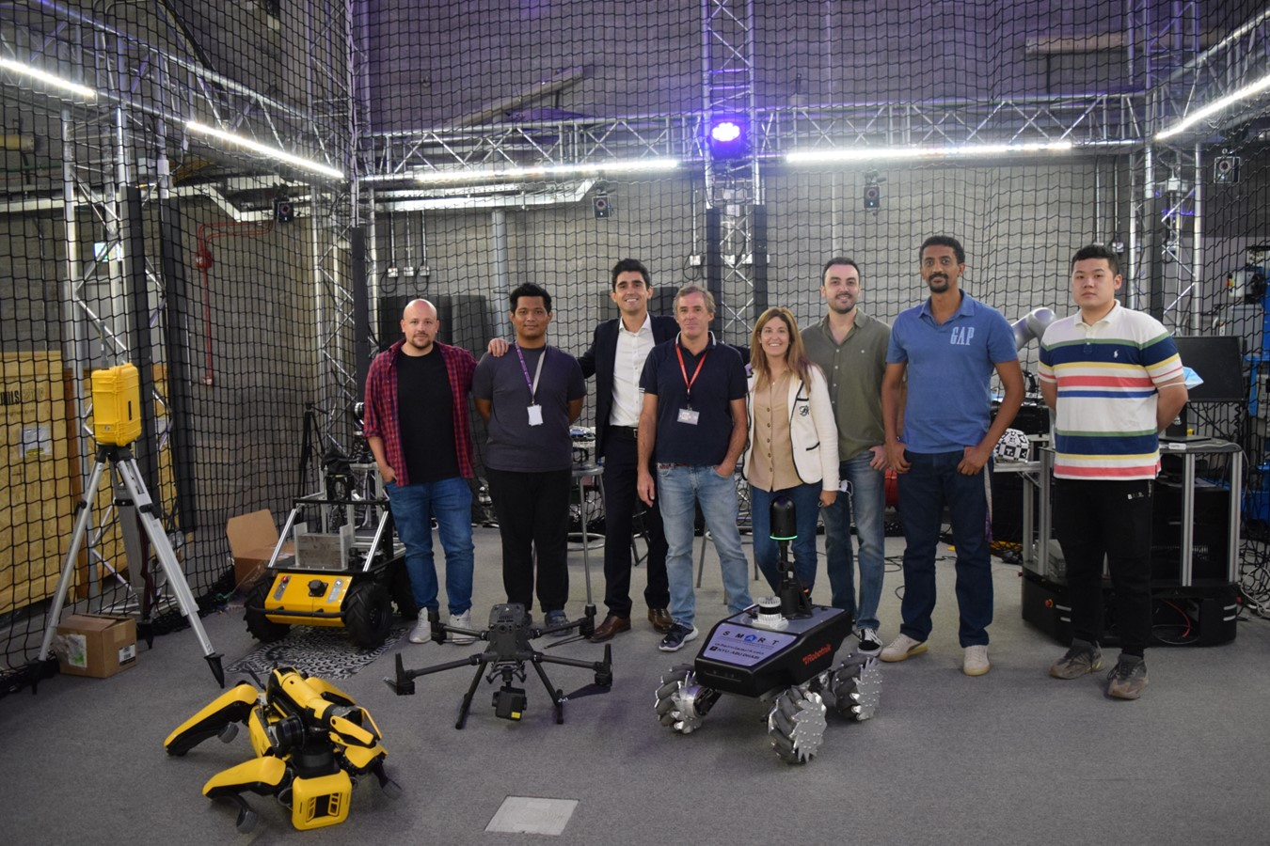




Robotics Research
at S.M.A.R.T.
Construction Lab
Borja García de Soto, PhD, PE

Slide 2


Sustainable and resilient construction
Overview
Modularization and lean construction
Our goal is to bridge scholarly excellence with practical application, optimizing every stage of the infrastructure lifecycle to build resilient future communities.
Artificial intelligence
Robotic systems and automation
Technology integration & information modelling

Slide 3


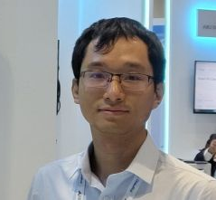




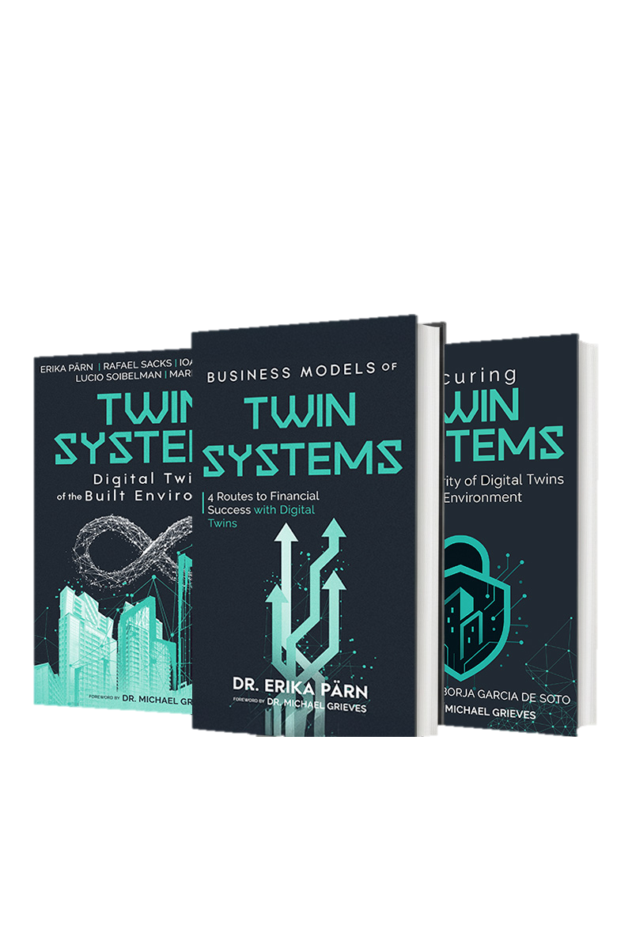



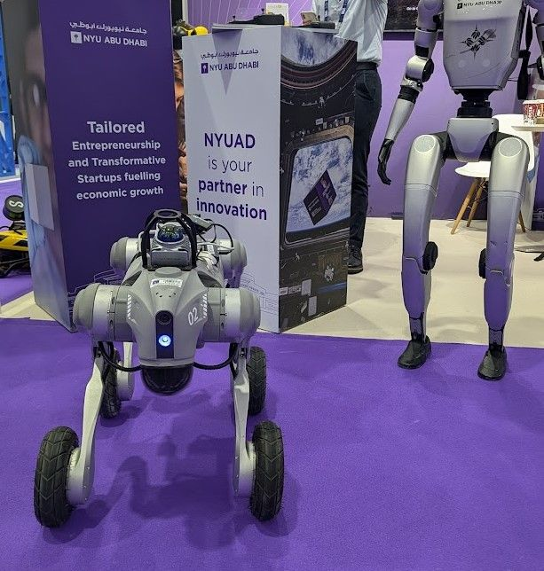
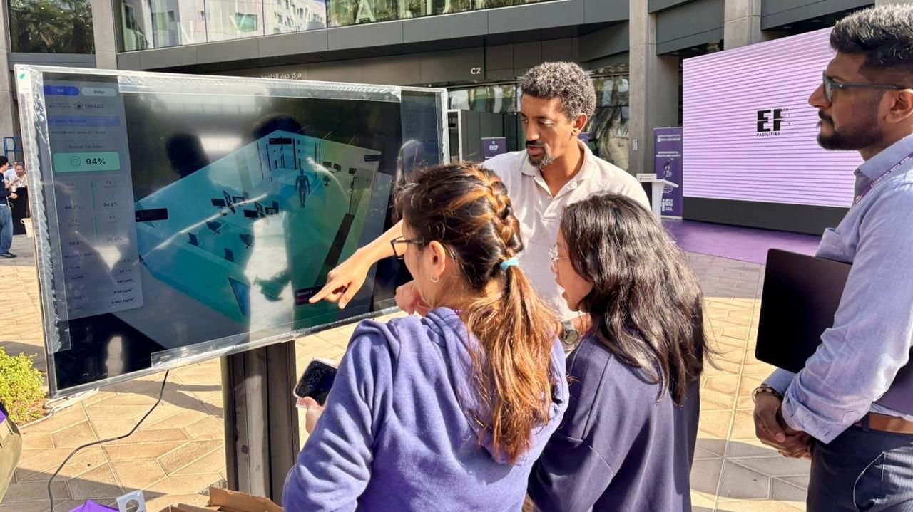

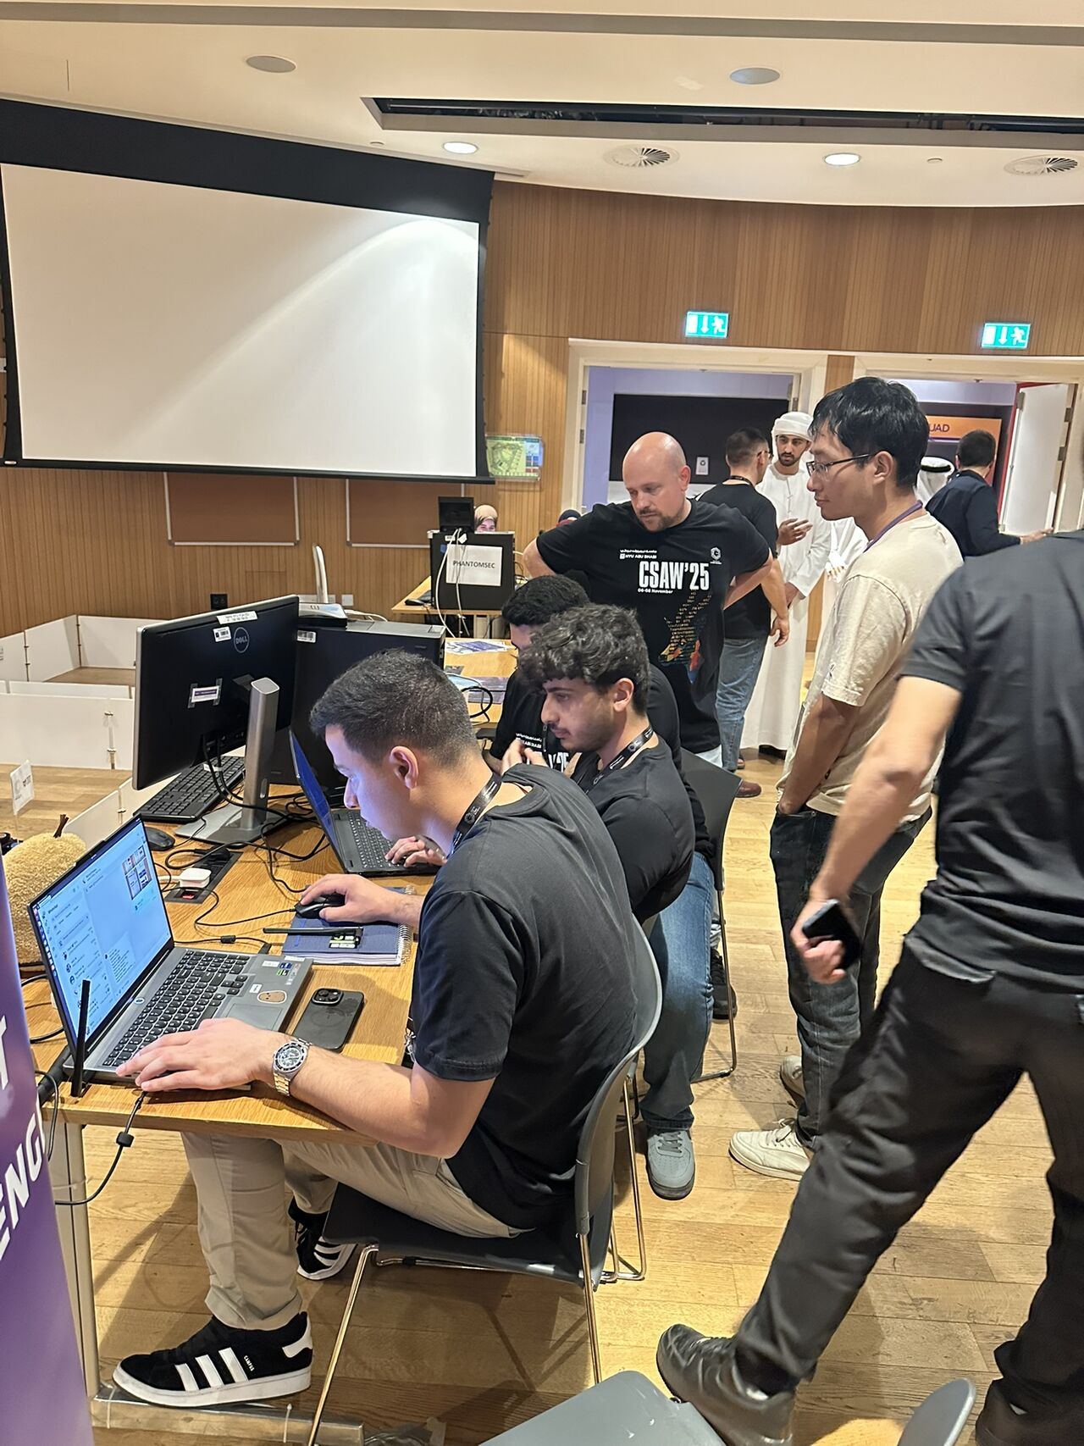
Research Team | people Of S.M.A.R.T. Labs
Borja García De Soto
Eyob Mengiste
Erika A. Pärn
Zihao Zheng
Associate Professor
Instructor and Researcher
Research Scientist
Postdoctoral Associate
Semih Sonkor
Dongchi (Daniel) Yao
Nas Gopee
Boyu Wang
PhD Student
Postdoctoral Associate
Research Assistant
Postdoctoral Associate

Slide 4
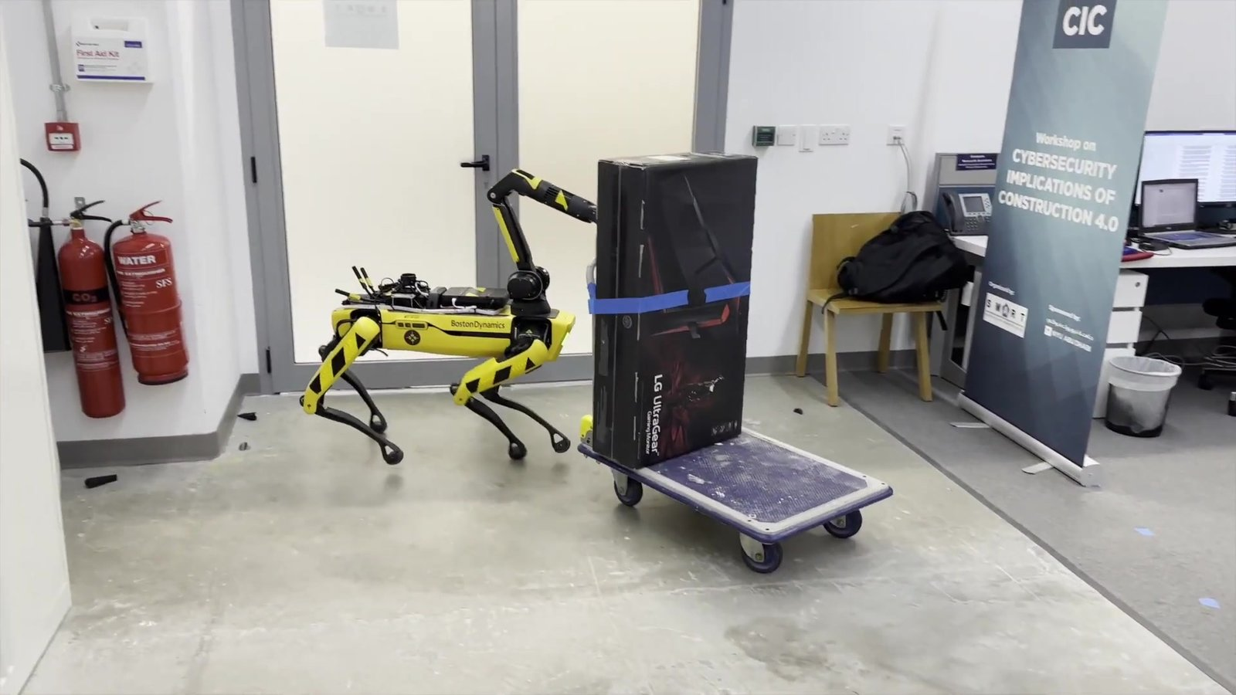
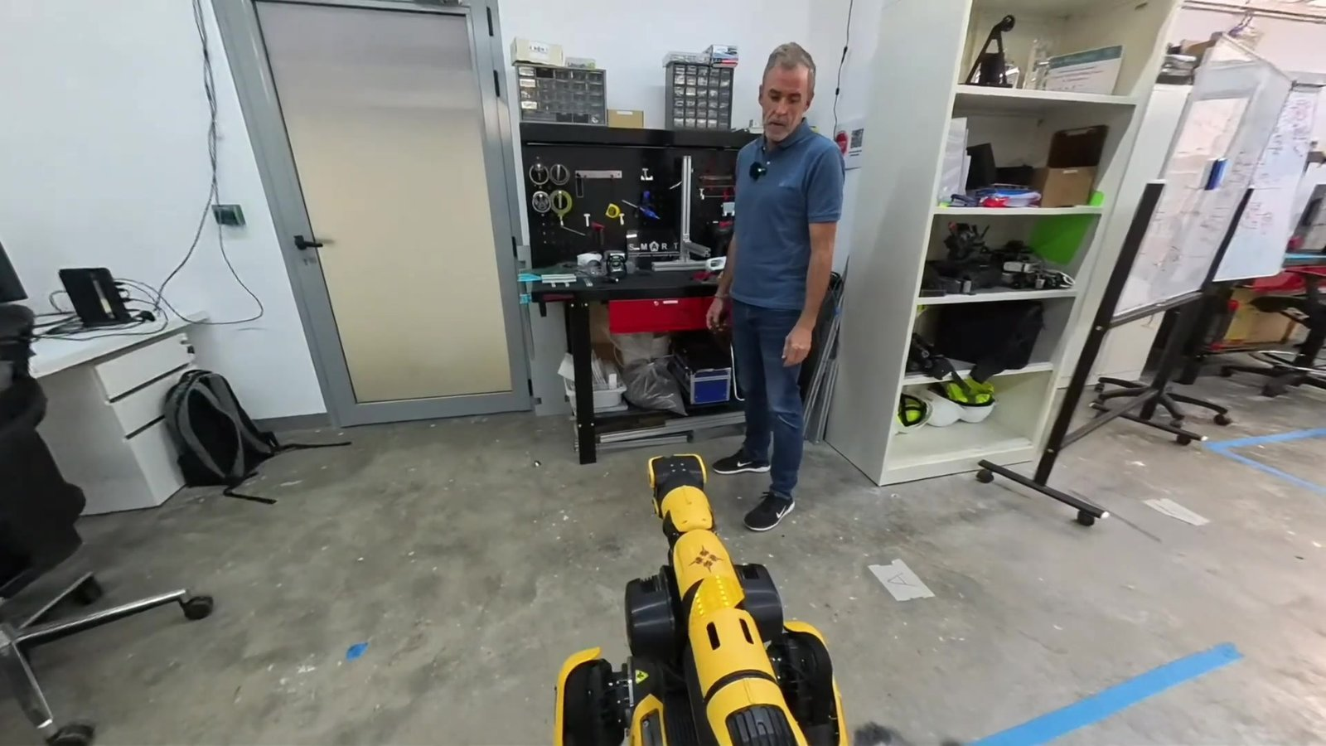
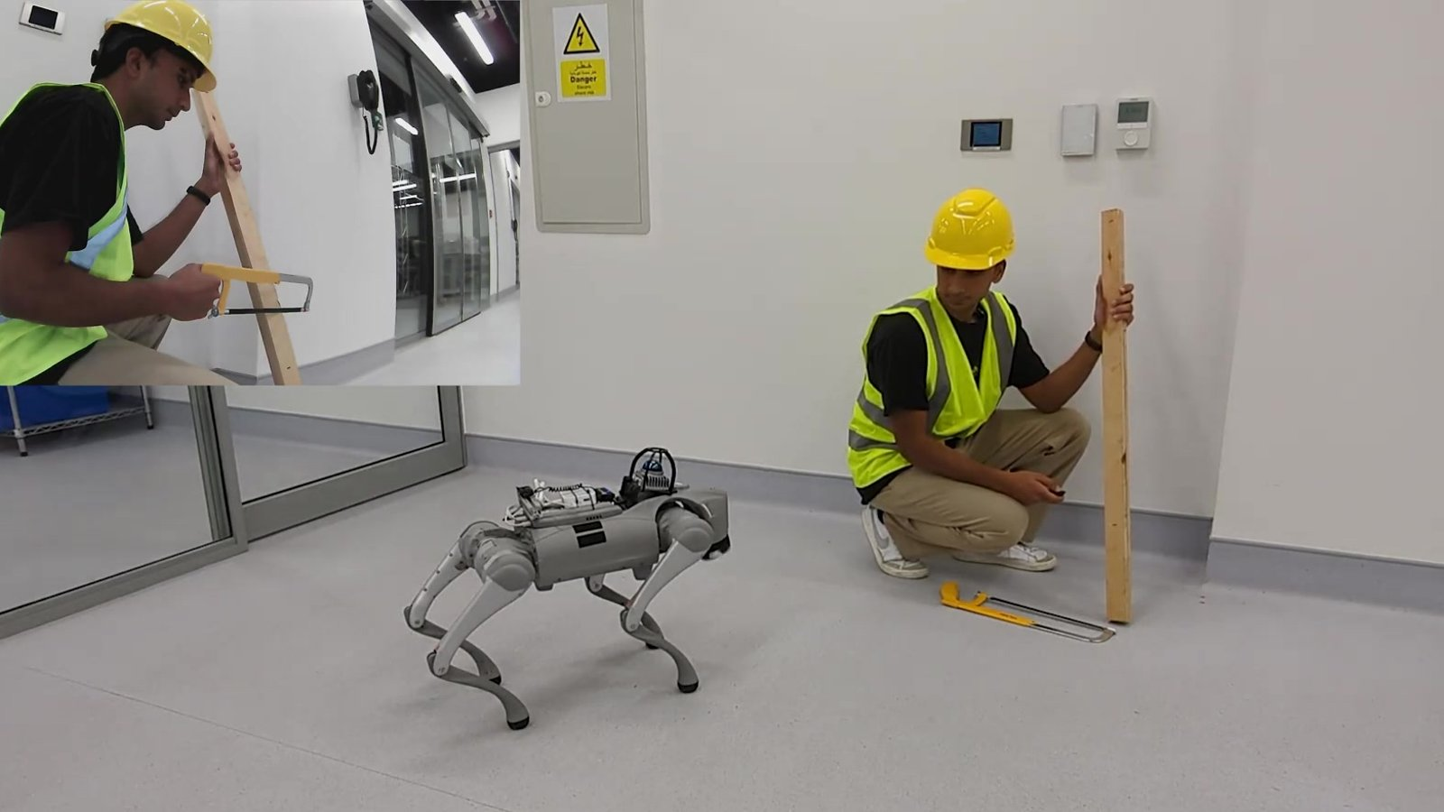
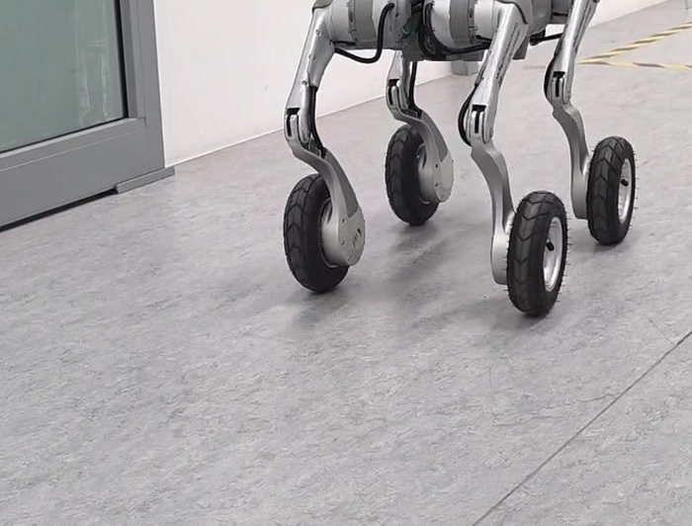
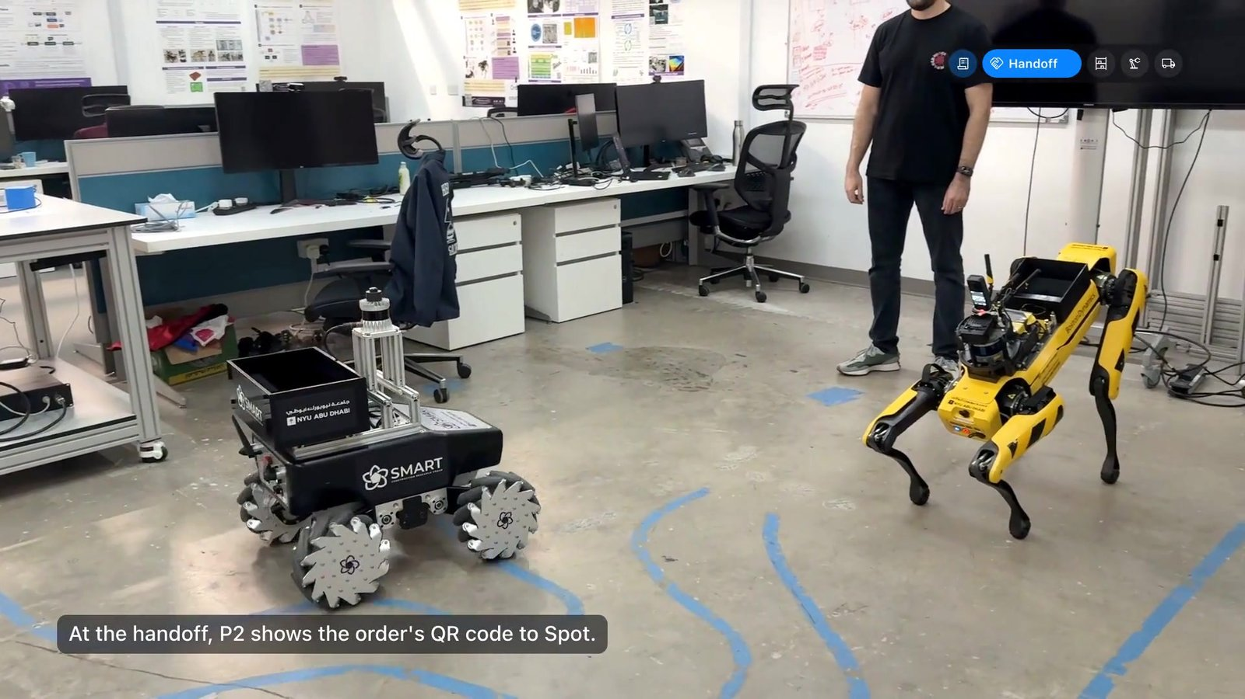
Our Robotics Research | Overview
02 PUBLICATIONS
03 LAB DEMONSTRATION
2.1
Multi-Agent Robotic System
2.2
PACA
2.3
LISA
2.4
SiteScope
3.1
Logistics Challenge
Robots and a human split the work to digitize a cluttered site.
Workers talk to a robot assistant; a cloud multimodal LLM plans its actions.
The same idea running locally: private, offline, speech-driven safety checks.
Schedule-driven robot inspections, from capture to published report.
Three robots and five people fill delivery orders together.
SUMMIT-XL · Spot with Arm
Spot with Arm
Go2 · Go2-W
Go2-W
SUMMIT-XL · Spot · FR3 arm
J. Field Robotics 2024
ICRA 2025 Workshop
CCC 2025 · AutCon 2026
IROS 2026 Workshop
AD Ports × NYUAD event 2026

Slide 5

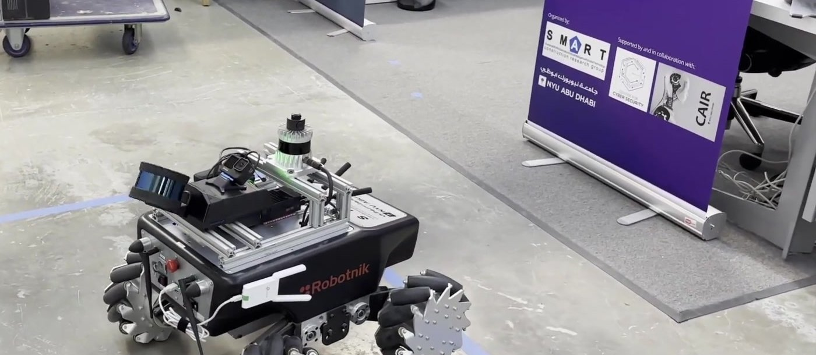

01
Robotic Platforms:
The Robots in Our Lab

Slide 6
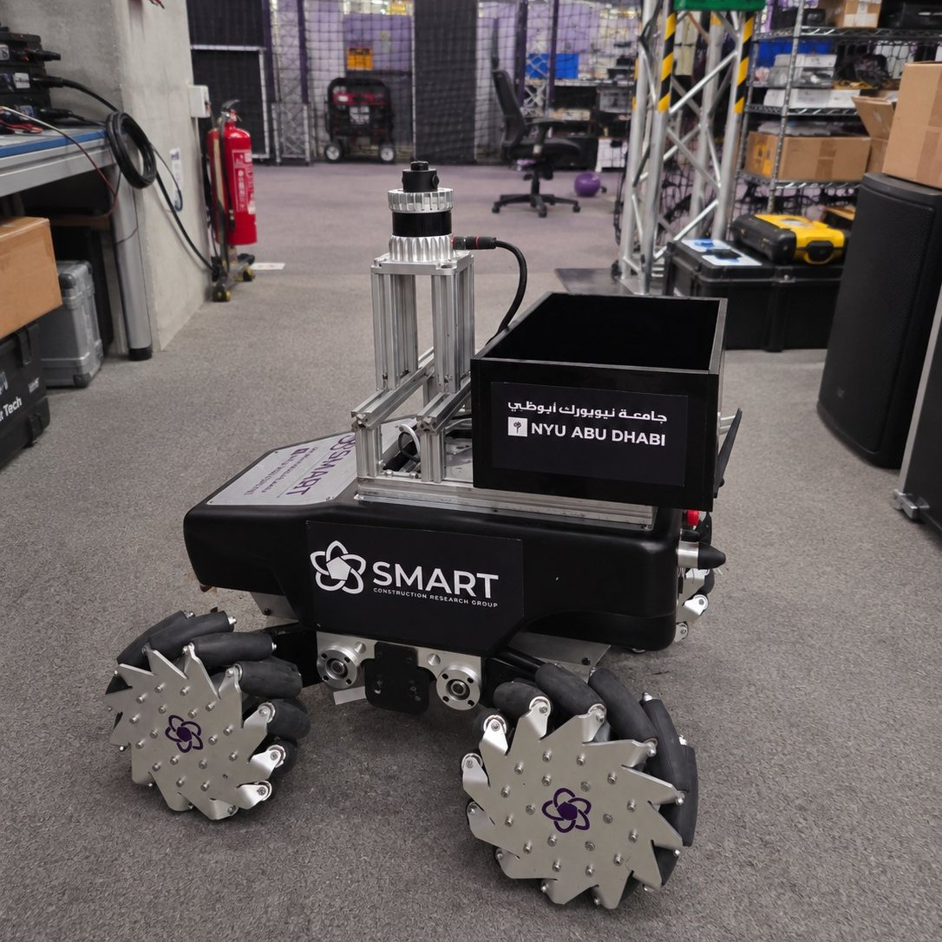
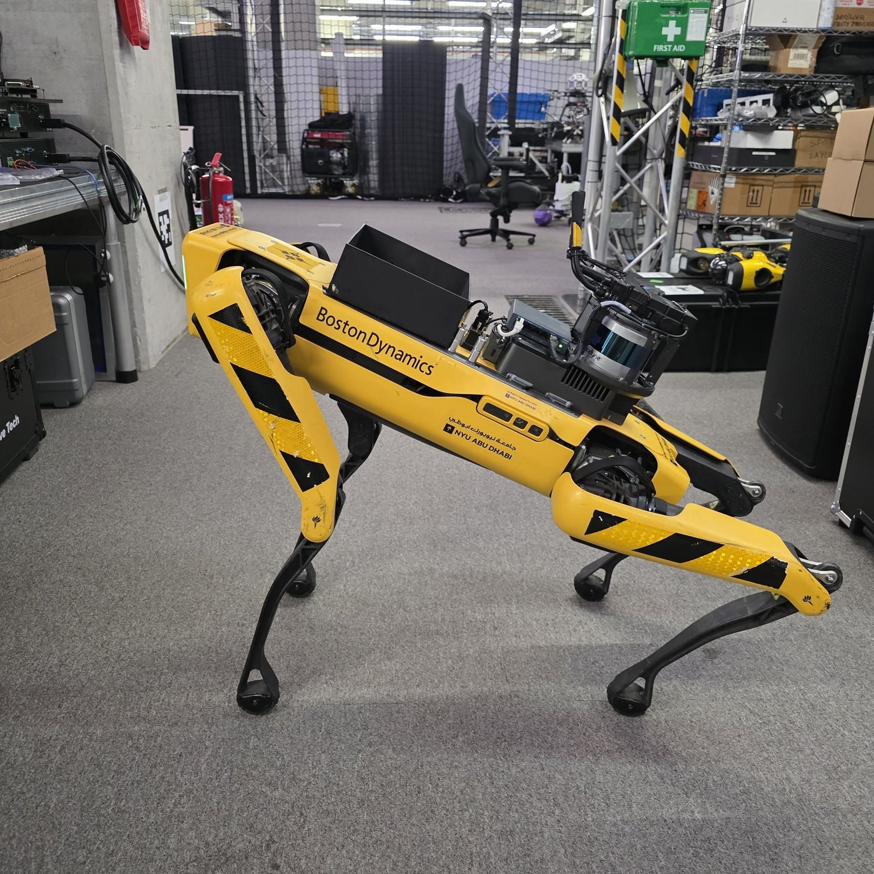
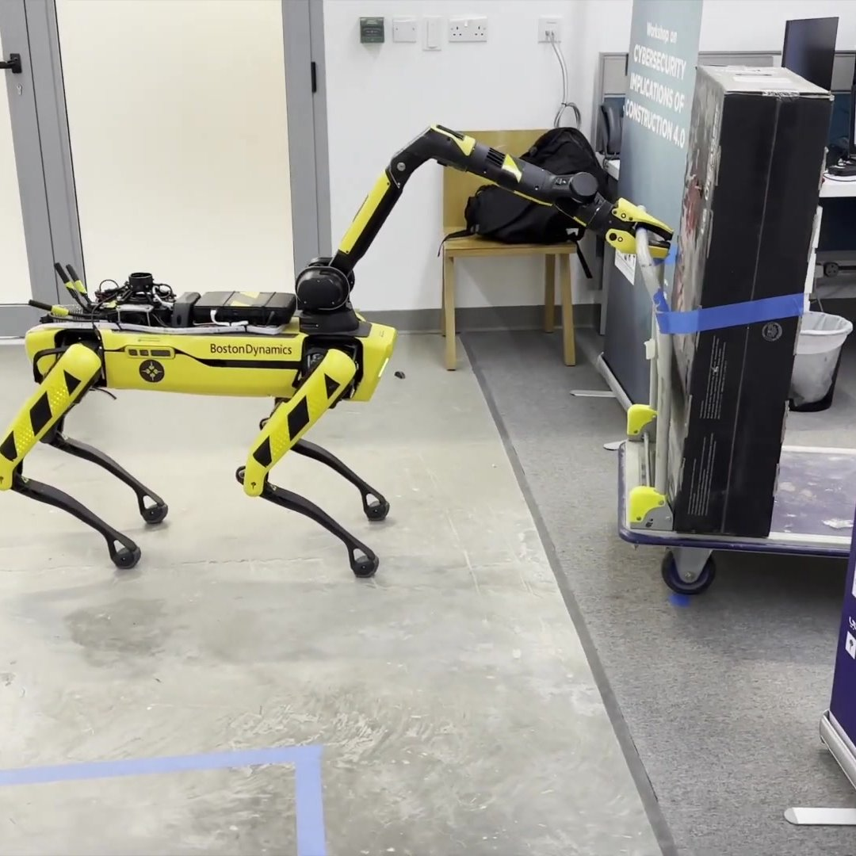
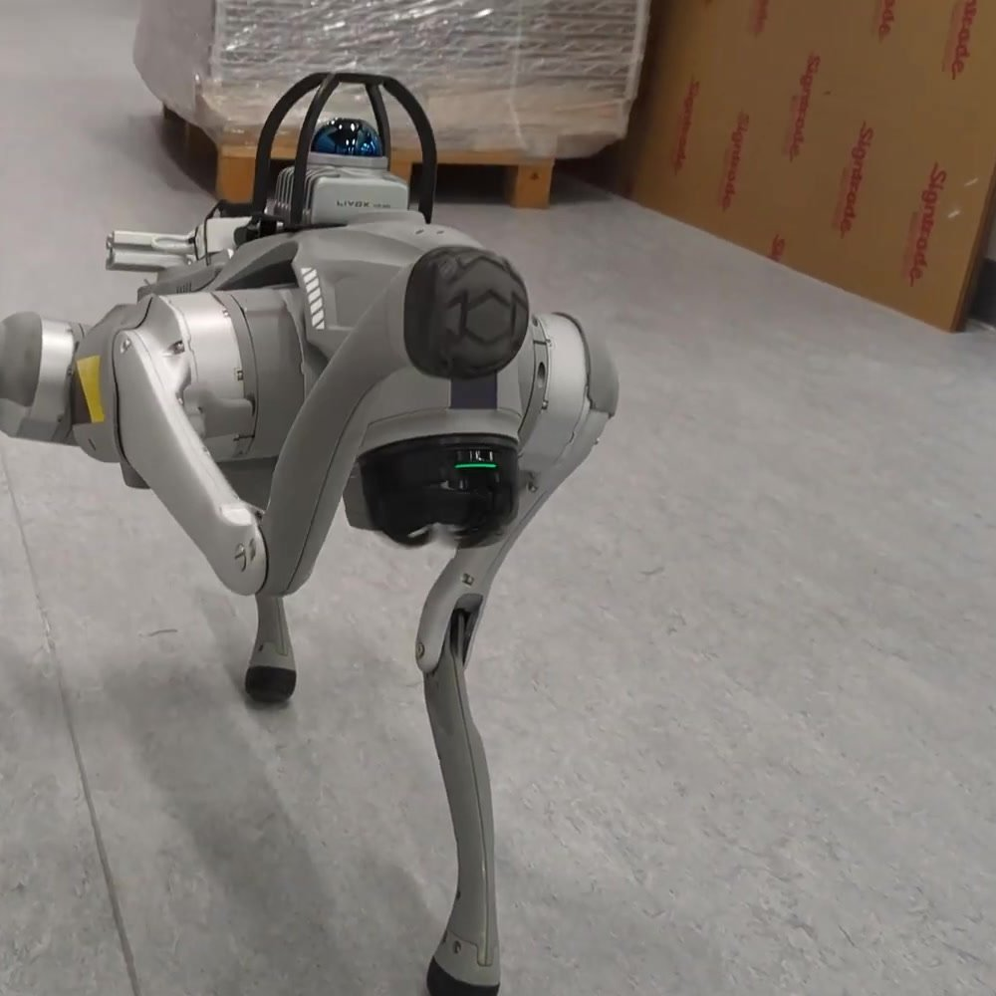
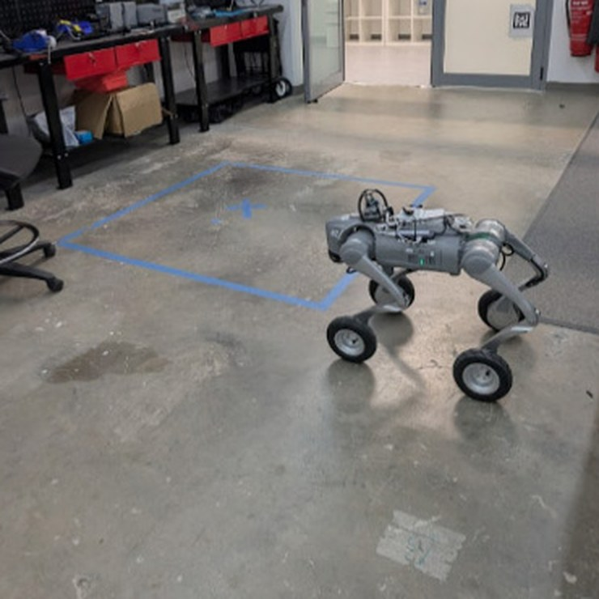
Robotic Platforms | Overview
1 PLATFORMS
SUMMIT-XL
Spot
Spot with Arm
Go2
Go2-W
Robotnik · omnidirectional wheeled base
Boston Dynamics · agile quadruped
6-DOF arm with two-finger gripper
Unitree · compact quadruped
Unitree · wheeled-legged hybrid
Used in
Used in
Used in
Used in
Used in
Multi-Agent · Logistics
Multi-Agent · Logistics
Multi-Agent · PACA
LISA (2025)
LISA (2026) · SiteScope · Logistics (backup)

Slide 7
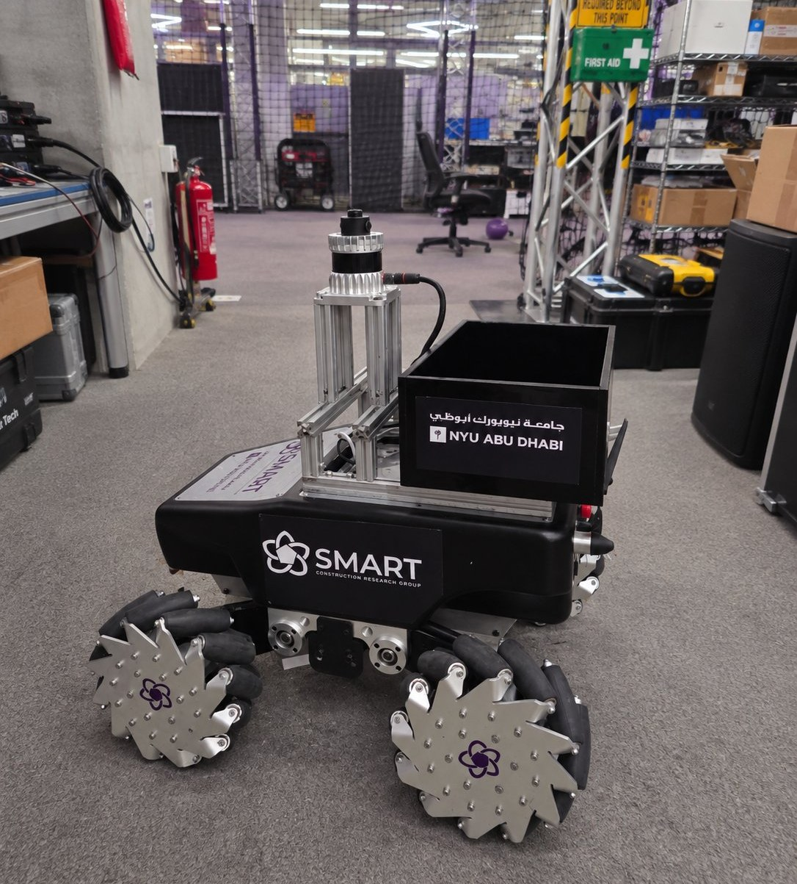

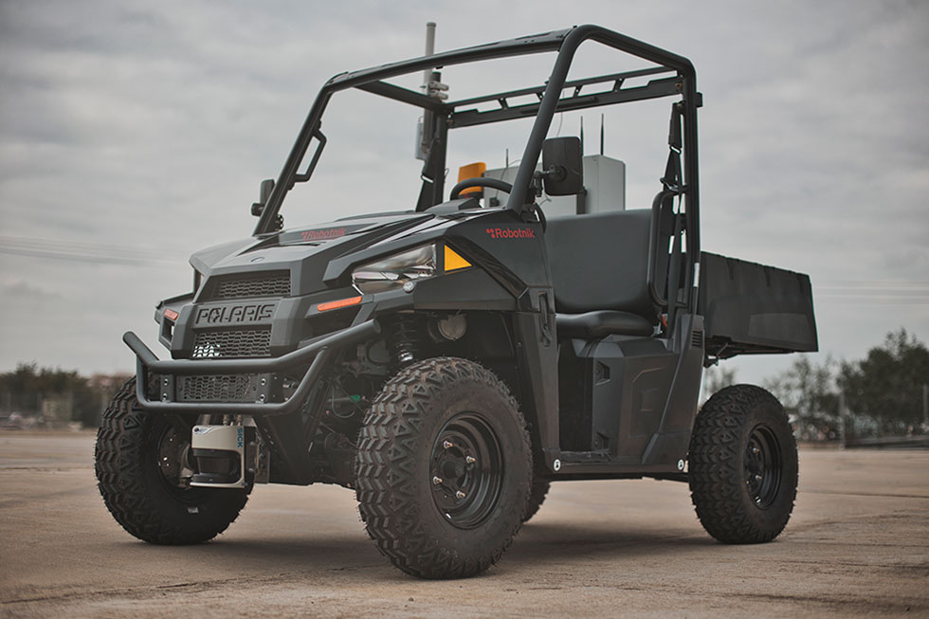
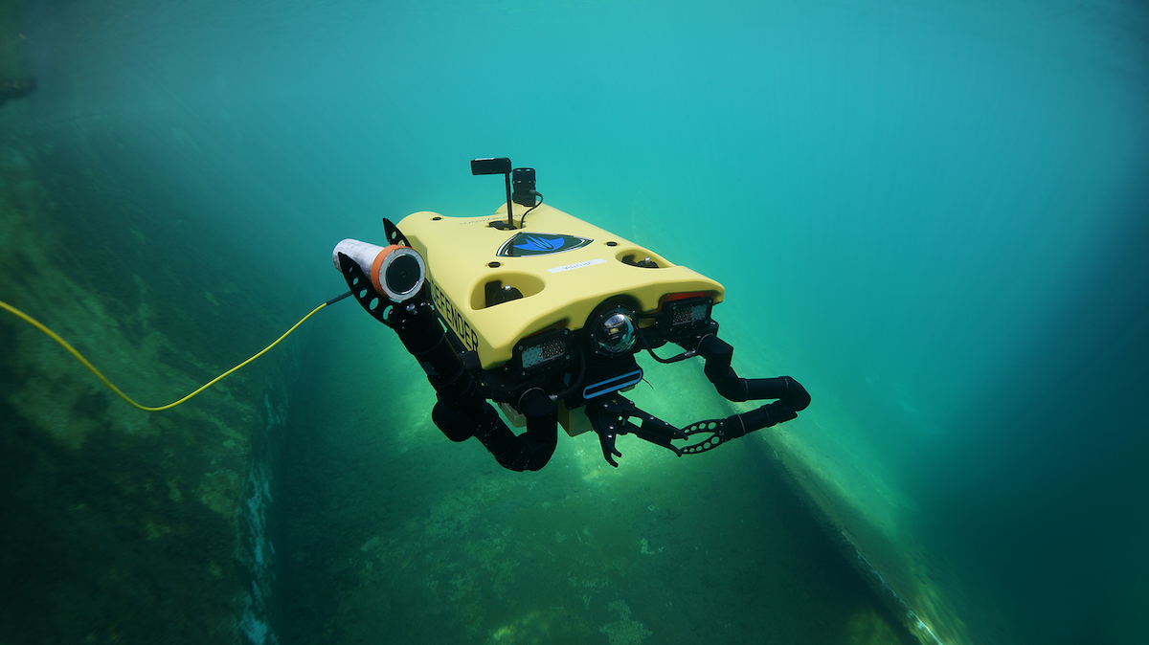

Robotnik SUMMIT-XL
Omnidirectional Mobile Base
Four-wheel mobile robot for indoor and outdoor sites.
Mecanum wheels: moves sideways and turns on the spot.
Independent suspension keeps all wheels on rough floors.
Our unit: Ouster OS-1-64 LiDAR, Astra camera, PX4 IMU, ROS.

Slide 8
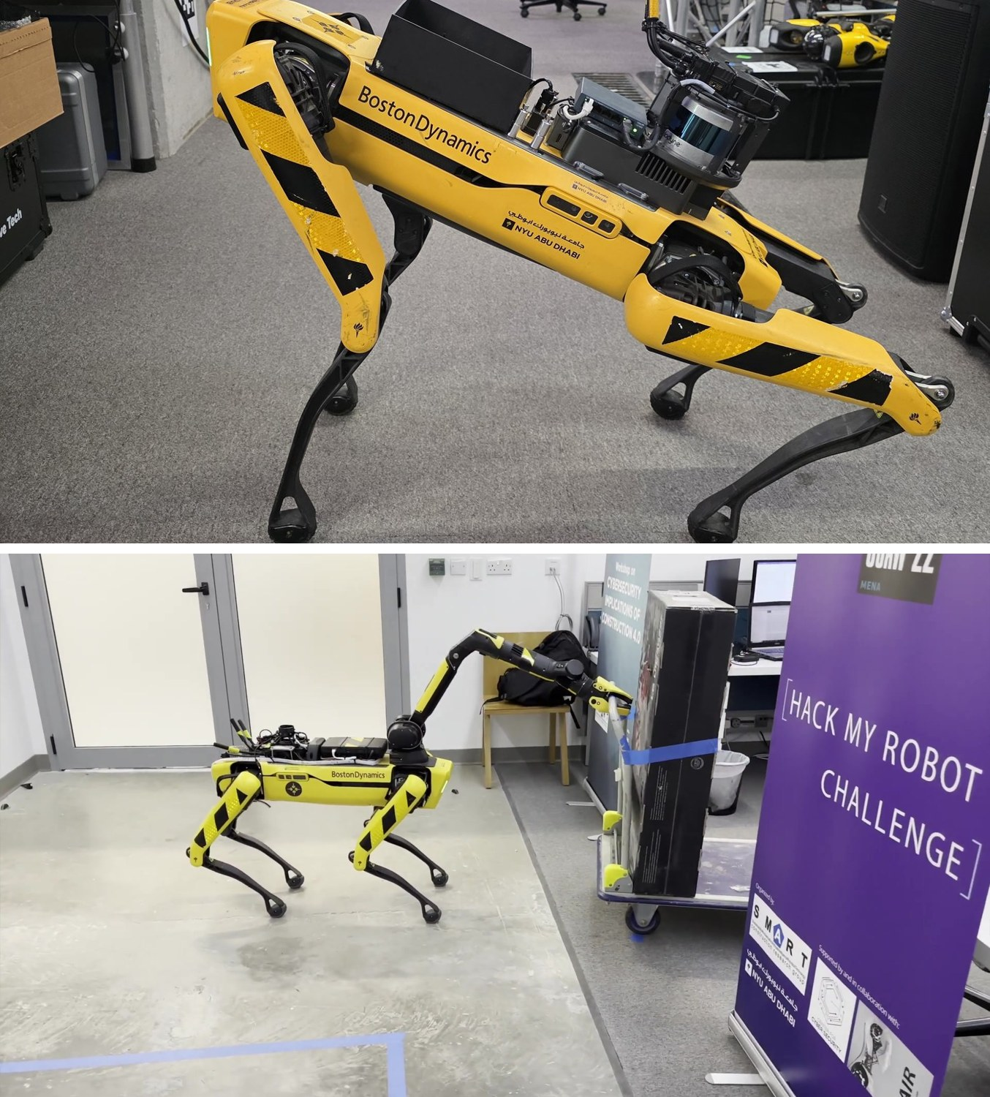
Spot
Boston Dynamics Spot
& Spot with Arm
Spot with Arm
Legged robot that climbs stairs and crosses rough ground.
Walks up to 1.6 m/s for about 90 minutes per battery.
Carries up to 14 kg on its rails; IP54 dust and water rating.
Arm: 6 joints and a gripper to open doors and pick objects.

Slide 9
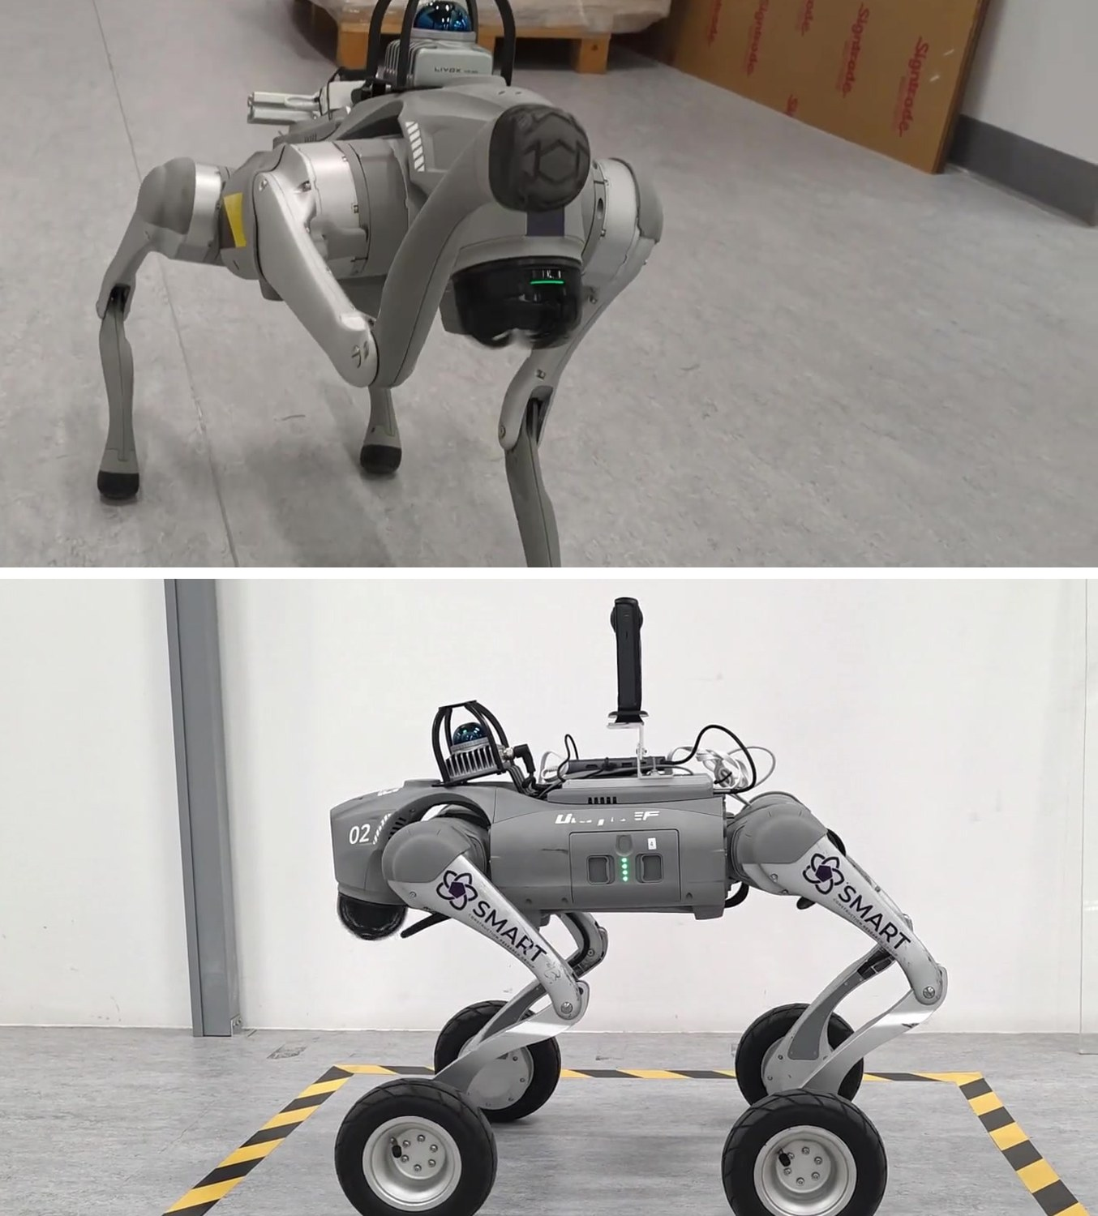
Go2
Unitree Go2 & Go2-W
Compact Legged Platforms
Go2-W
Go2: light (~15 kg) quadruped with a built-in LiDAR and camera.
Go2-W: wheels on its legs; it rolls on flat floors and steps up.
Go2-W: up to 2.5 m/s and 35° slopes; 1.5–3 h per battery.
Both are open to research code through an SDK and ROS 2.

Slide 10
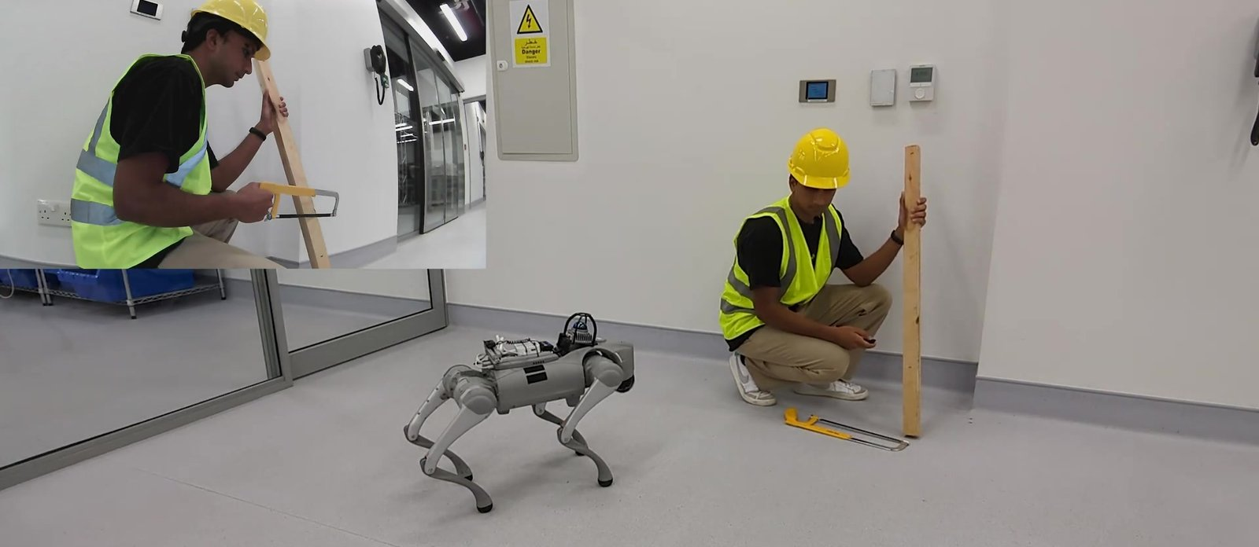
02
Publications:
Four Projects, Five Papers

Slide 11
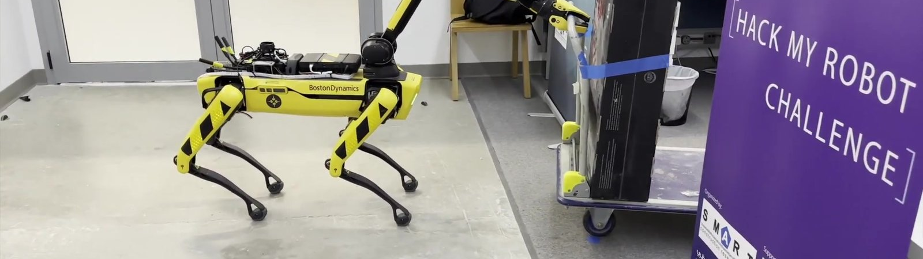
PUBLICATION
Multiagent robotic systems and exploration algorithms: Applications for data collection in construction sites
Journal of Field Robotics, 41(4), 1187–1203 · 2024
doi:10.1002/rob.22316
S. A. Prieto, N. Giakoumidis, B. García de Soto
2.1
Multi-Agent Robotic System
Robots SUMMIT-XL · Spot with Arm

Slide 12
Multi-Agent System | Introduction
2.1 MULTI-AGENT
The challenge
1
Sites change every day: clutter, closed doors and materials block a single robot.
2
No single robot can scan, open doors and move obstacles.
3
Standard exploration stops when it runs out of frontiers, not when the job is done.
Our idea
A team of robots and a human on one shared network, which splits the work, asks each other for help, and uses the BIM to know how much is left to explore.
2 + 1
~80 m²
robots + human agent
occluded space digitized
[1] Prieto, Giakoumidis & García de Soto (2024). Journal of Field Robotics 41(4), 1187–1203. doi:10.1002/rob.22316

Slide 13
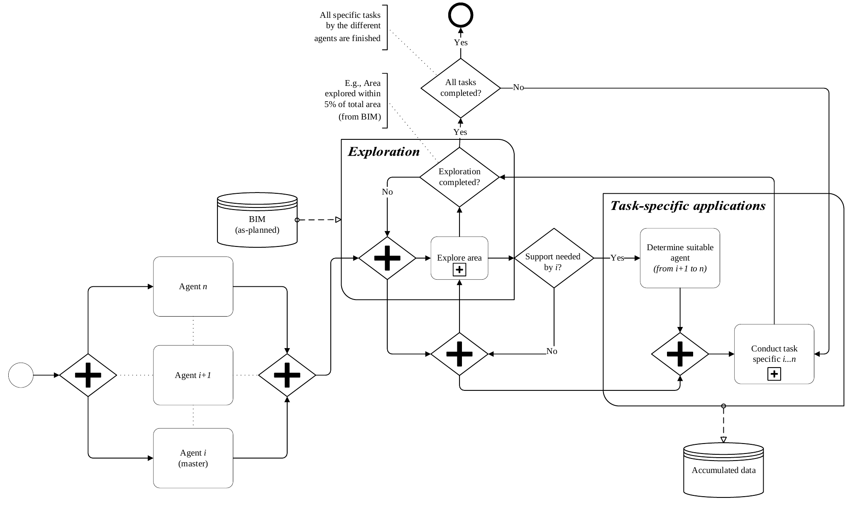
Multi-Agent System | Methodology
2.1 MULTI-AGENT
1
Start in parallel
All agents launch at once; agent i is the master.
2
Explore
Frontier-based exploration maps the site in real time.
3
Ask for help
A blocked agent calls the best-suited agent (i+1 … n).
4
Stop using BIM
Finish when the explored area reaches the BIM floor plan: φ = ΣPexp / ΣPGT × 100%
BPMN of the multi-agent methodology [1]

Slide 14
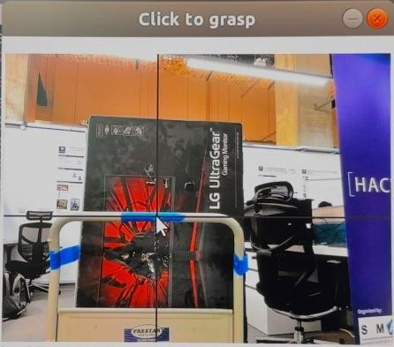
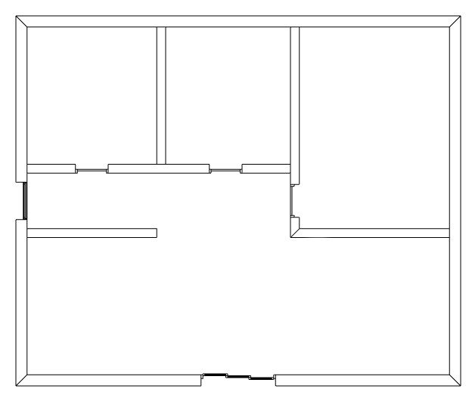

Multi-Agent System | System Components
2.1 MULTI-AGENT
RA1 · SUMMIT-XL
RA2 · Spot with Arm
Human Agent
Explores and scans: builds the navigation map and the 3D point cloud.
Assists: opens doors and removes obstacles that block RA1.
Supervises remotely and marks a grasp point when the robot asks.
BIM → ground truth
IFC floor plan sliced into a free-space map for the stopping rule.
One shared network
MANET radios: 2.42 GHz · 3×3 MIMO · AES-256
ROS master links all agents and the control station
Custom help-request topic dispatches the right agent

Slide 15
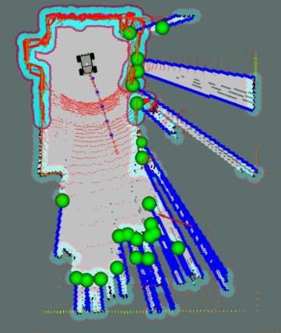
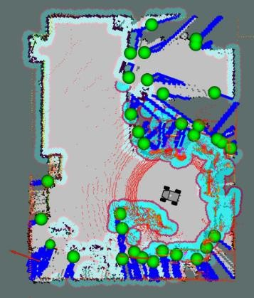
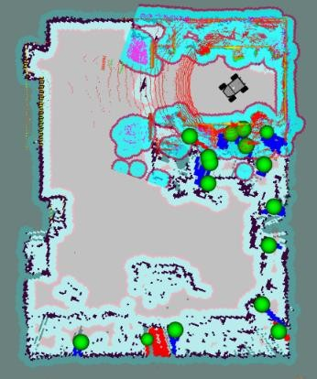
Multi-Agent System | Results
2.1 MULTI-AGENT
φ = 49.5%
φ = 84.5%
φ = 95.8%
Exploring
Blocked: help requested
Path cleared: done
Why the BIM matters: standard exploration would have stopped at 84.5%, with no frontiers left. Because the explored area was compared with the BIM, the system knew a room was missing and called Spot to clear the way.

Slide 16
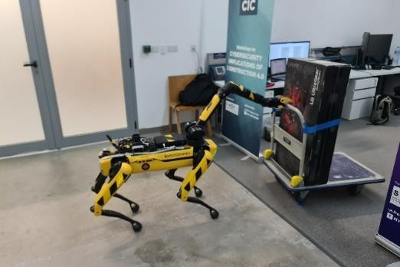
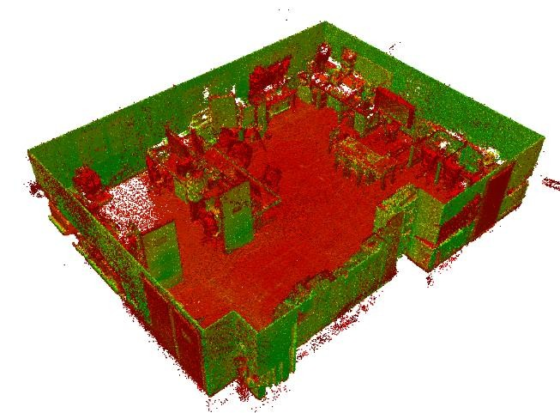
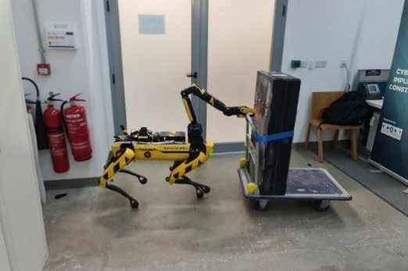
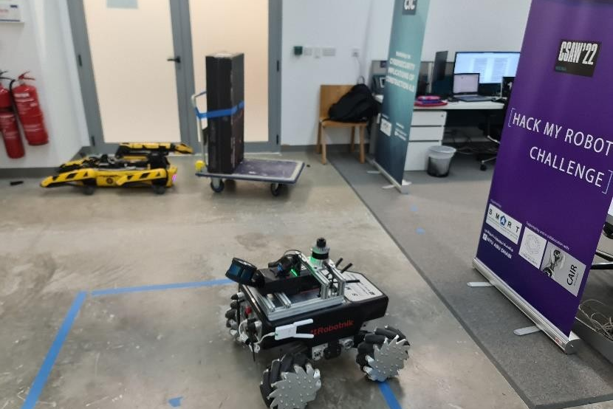
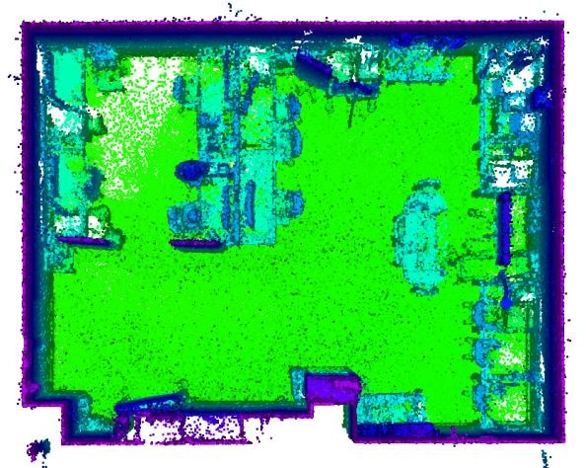
Multi-Agent System | Collaboration & Output
2.1 MULTI-AGENT
1
2
Human marks the grasp point remotely
Spot grasps the obstacle
3
4
Output
Registered 3D point cloud of the whole space, plus the global map, from a single mission.
…and clears the doorway
SUMMIT-XL resumes exploring

Slide 17
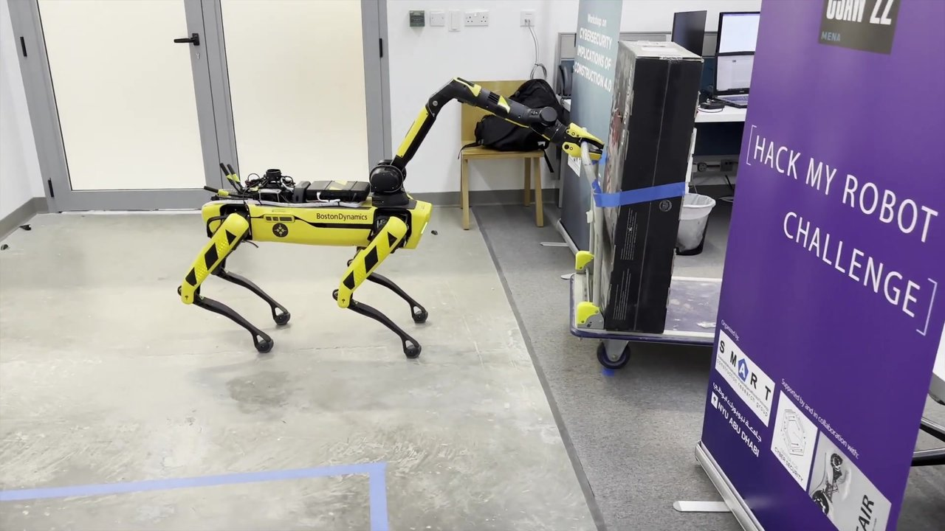
Multi-Agent System | Video
2.1 MULTI-AGENT
Video placeholder
Insert › Video › This Device: Media/Videos/Multi-agent_robotic_system__An_example_for_data_collection(1080p).mp4
Full video: two robots and a remote human agent digitize an occluded space

Slide 18
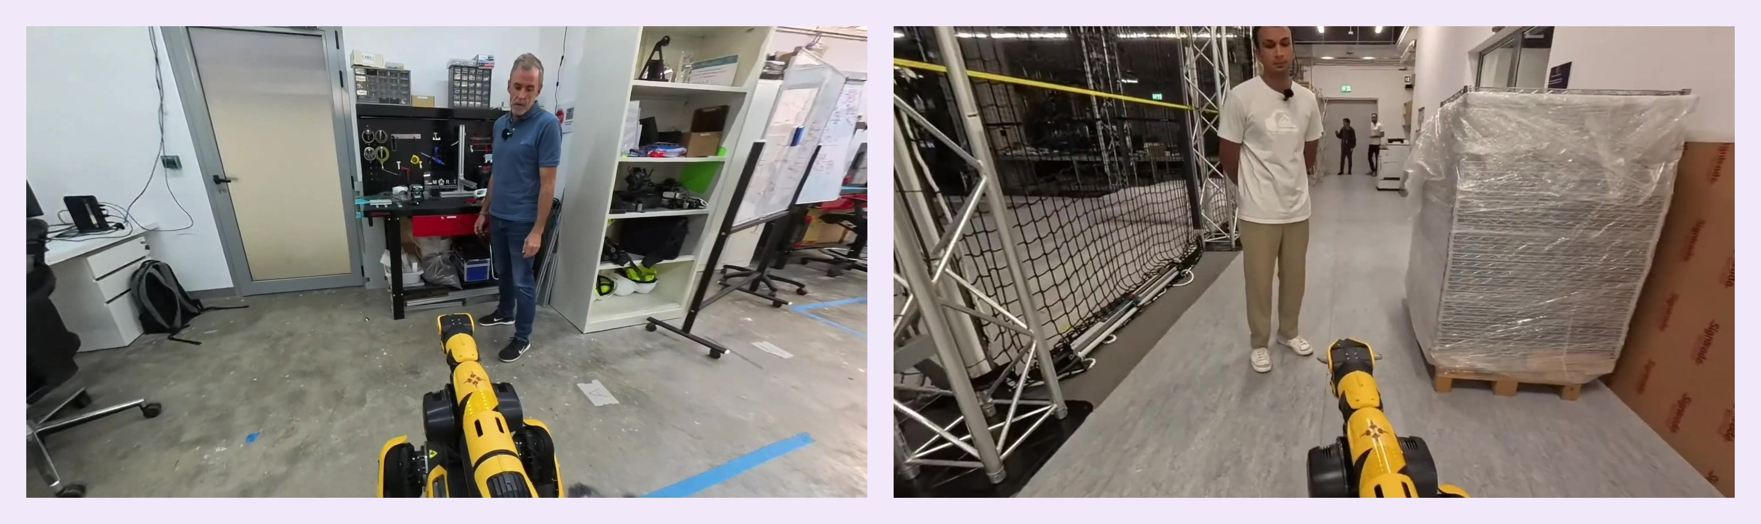
PUBLICATION
PACA: A Personal Autonomous Construction Assistant to facilitate human-robot interaction
4th Workshop on the Future of Construction, IEEE ICRA 2025 · Atlanta
construction-robots.github.io/papers/112.pdf
S. A. Prieto, B. García de Soto
2.2
PACA
Robots Spot with Arm

Slide 19
PACA | Introduction
2.2 PACA
The challenge
1
Most site workers have no training in robotics.
2
Tablets and programming interfaces don't work well on site.
3
Multinational crews need to be understood in their own language.
Our idea
Workers simply talk to the robot. A multimodal LLM understands the request, looks at the scene when needed, answers by voice, and turns intent into robot actions.
Voice
Vision
in and out, multilingual
image-based reasoning
[2] Prieto & García de Soto (2025). PACA. 4th Future of Construction Workshop, IEEE ICRA 2025 (construction-robots.github.io/papers/112.pdf)

Slide 20
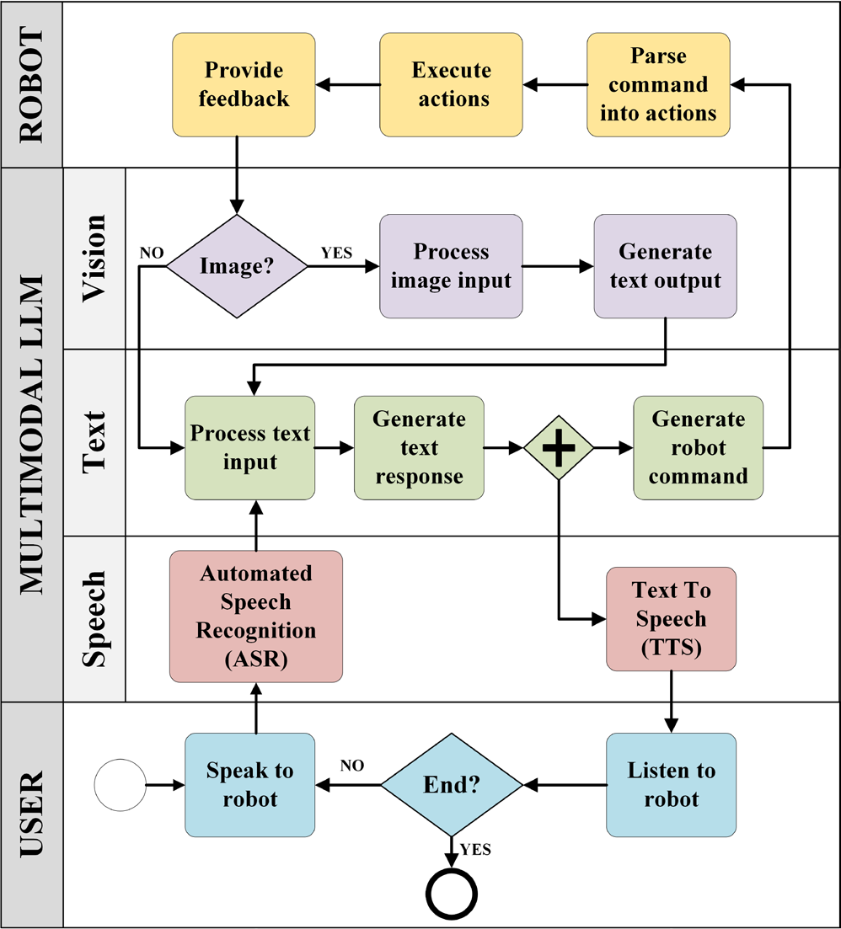
PACA | Methodology
2.2 PACA
1
Speak
The worker presses a button and talks; a wireless audio receiver captures the speech.
2
Understand
Speech-to-text (whisper-1) feeds a multimodal LLM (gpt-4-turbo) whose system prompt lists the tasks and the robot API.
3
See
When needed, the arm camera takes a picture for image-based reasoning.
4
Act and reply
Outputs are parsed into Spot API actions; text-to-speech (tts-1) streams the reply.

Slide 21
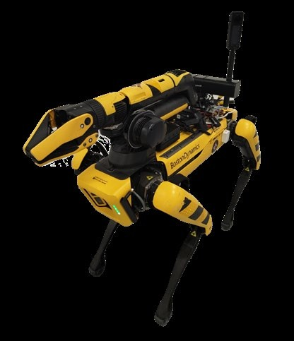
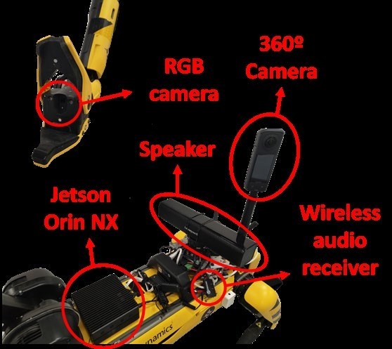
PACA | Implementation on Spot
2.2 PACA
Hardware
Jetson Orin NX 16 GB
Wireless audio receiver
Speaker · arm RGB camera
Insta360 X4 · remote button
Software
ASR: whisper-1
LLM: gpt-4-turbo (cloud)
TTS: tts-1, streamed
Boston Dynamics Python API
Spot with Arm carrying the PACA payload [2]
Robot actions: go to inventory · go to worker · take picture · pick up tool

Slide 22
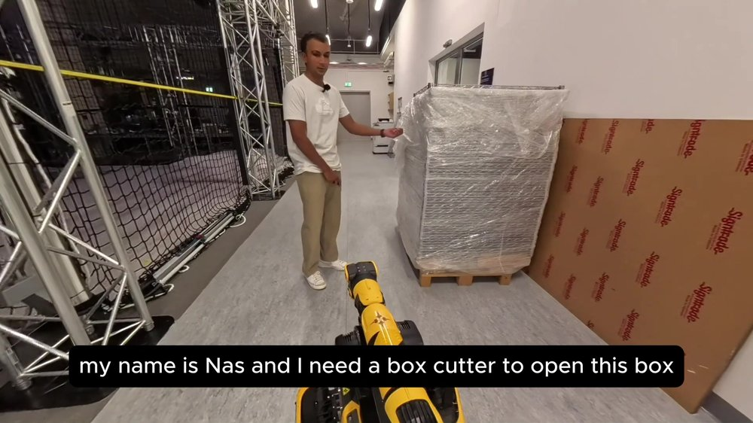
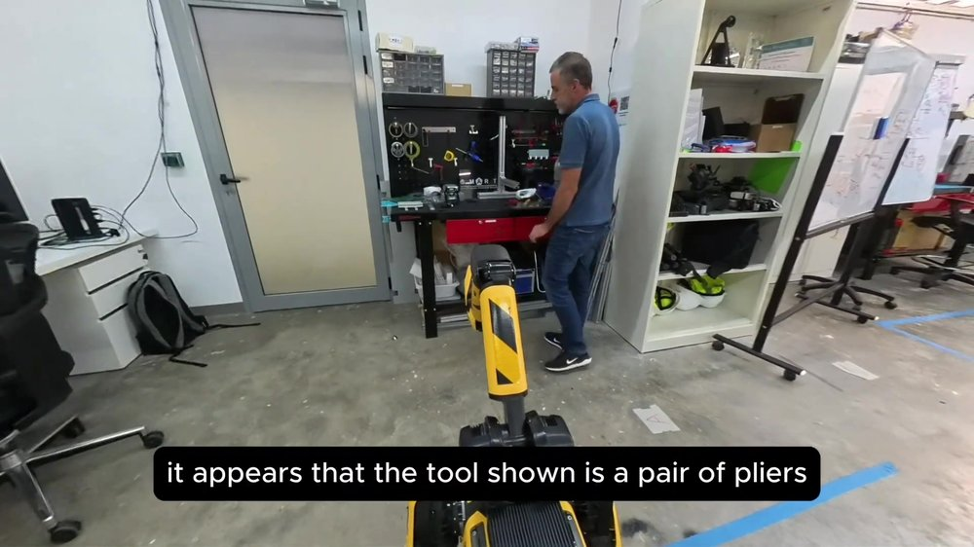
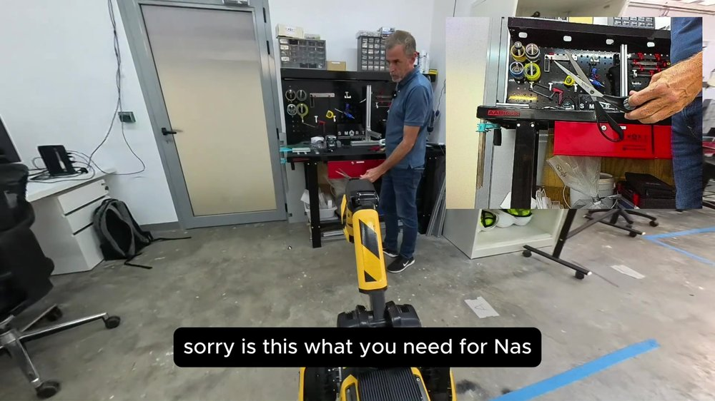
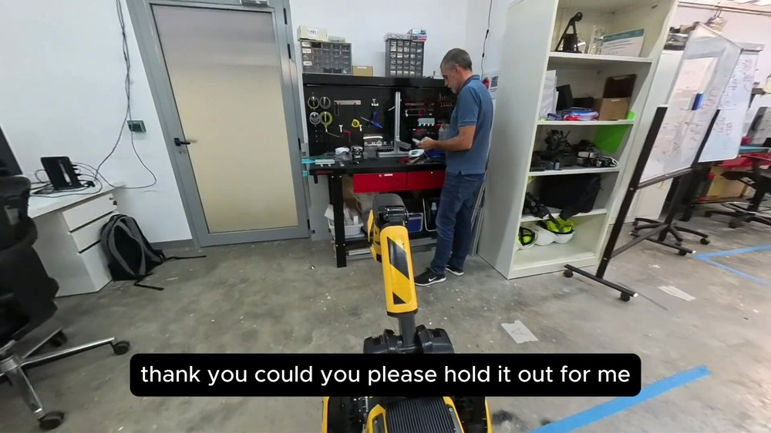
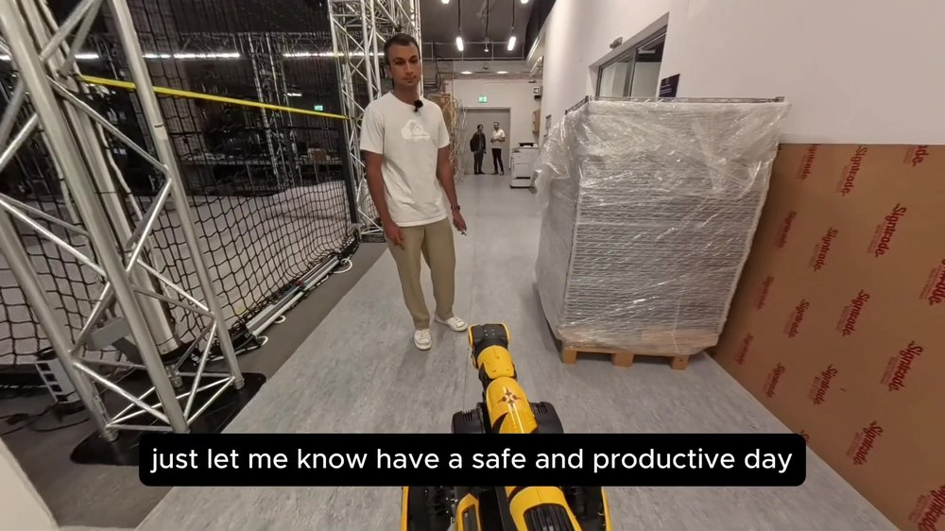
PACA | Case Study: Fetching a Tool
2.2 PACA
1
2
3
A worker asks PACA for a box cutter.
Wrong tool shown: PACA sees pliers and asks again.
The right tool is shown and confirmed.
4
5
What it shows
Dialogue with two people: worker and inventory manager
Vision rejects the wrong tool
Next: cloud dependency adds latency, which led to LISA
PACA asks the manager to hold it out and grasps it.
The tool is delivered back to the worker.

Slide 23

PACA | Video
2.2 PACA
Video placeholder
Insert › Video › This Device: Media/Videos/PACA__The_Personal_Autonomous_Construction_Assistant_🏗️🤖(1080p).mp4
Full video: PACA fetches a tool for a worker through spoken dialogue

Slide 24
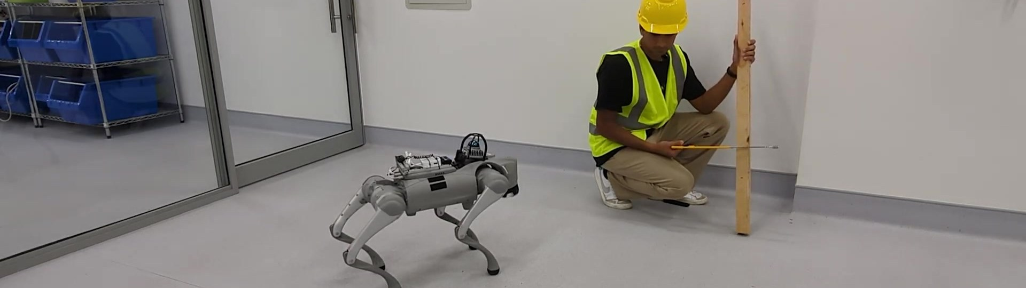
PUBLICATION
Enhancing human-machine interaction with on-device large language models in construction robotics: A case study on safety applications
Creative Construction Conference 2025
doi:10.22260/CCC2025/0041
Self-hosted multimodal large language models for speech-driven perception and navigation in construction robotics
Automation in Construction, 183, 106805 · 2026
doi:10.1016/j.autcon.2026.106805
M. A. Gopee, S. A. Prieto, B. García de Soto
2.3
LISA
Robots Go2 · Go2-W

Slide 25
LISA | Introduction
2.3 LISA
The challenge
1
Cloud LLMs need a stable connection, which construction sites rarely have.
2
Latency: cloud replies took over 45 s on low bandwidth.
3
Site images and workers' voices are sensitive data.
Our idea
Run speech, vision and the LLM on site, on the robot or a nearby edge server, so the assistant keeps working offline and data never leaves the site.
> 45 s
5–10 s
cloud reply, low bandwidth
LISA reply, fully on-device
[3] Gopee, Prieto & García de Soto (2025). CCC 2025. doi:10.22260/CCC2025/0041 [4] Gopee, Prieto & García de Soto (2026). Autom. Constr. 183, 106805. doi:10.1016/j.autcon.2026.106805

Slide 26
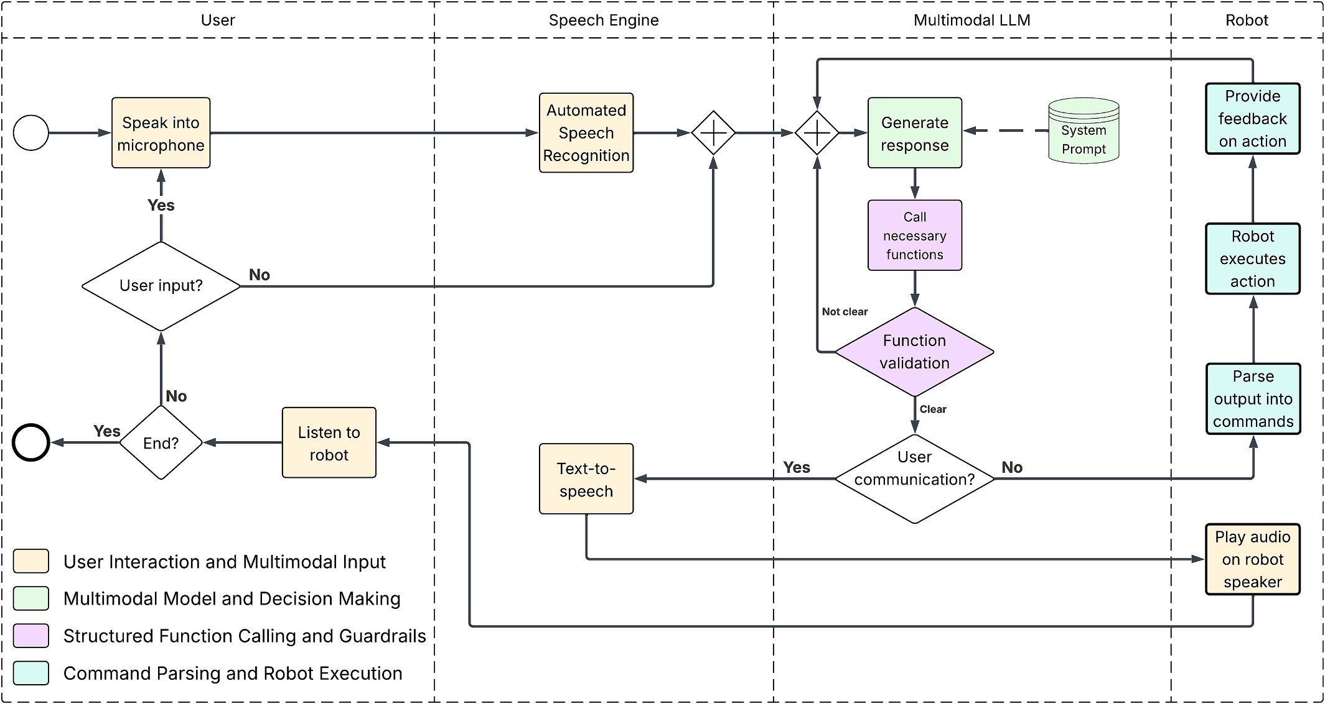
LISA | Methodology
2.3 LISA
Five robot functions
navigate_to(location)
take_picture()
analyze_image()
speak(text)
activate_safety_protocol()
Guardrails
Every call is checked against a fixed schema before it runs; anything invalid falls back to dialogue.
BPMN of the LISA framework; navigation runs through ROS 2 (Nav2 + AMCL) [4]

Slide 27
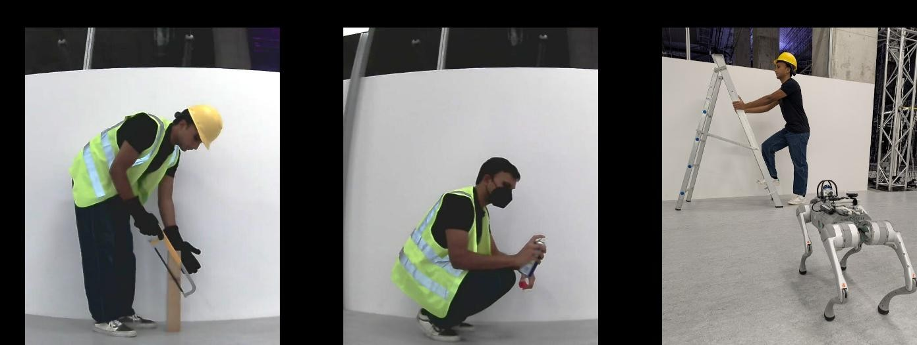
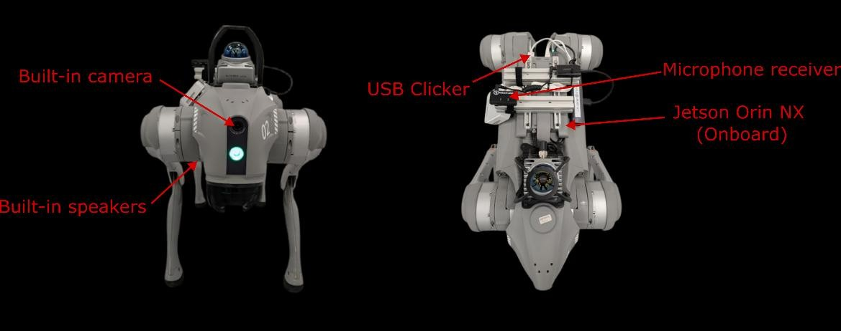
LISA v1 | Fully On-Device on Go2
2.3 LISA
Activity | Required PPE | LISA's verdict
Cutting wood | Hard hat, vest, gloves | ✓ Compliant
Aerosol use | Hard hat, vest, mask | ✗ Missing hard hat
Climbing ladder | Hard hat, vest, harness | ✗ Missing vest, harness
Everything runs on the robot
Gemma 3 12B
Whisper base (ASR)
Piper TTS
Jetson Orin NX 16 GB
Push-to-talk
5–10 s
0
typical spoken reply
cloud calls
PPE compliance test: images captured by the Go2's own camera [3]

Slide 28
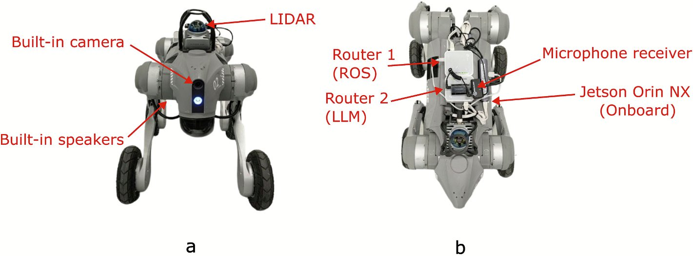
LISA v2 | On-Robot vs. Edge Server
2.3 LISA
ON-ROBOT
EDGE SERVER
Gemma 3 4B
Gemma 3 27B
Jetson Orin NX 16 GB
RTX 4090 workstation, same LAN
Works fully offline
More reasoning; data stays on site
Four workflows of increasing complexity · 2 models × 4 experiments × 5 runs = 40 runs
1
5
6
13
step · Exp 1
steps · Exp 2
steps · Exp 3
steps · Exp 4
“Go to the work area.”
“Inspect the work area.”
“Inspect and report back at the station.”
PPE violation detected
A single navigation call
Navigate, photo, analyze, speak
Adds a return trip
Warn worker, fetch hard hat, report

Slide 29
LISA v2 | Results
2.3 LISA
2.45–3.18 s
100%
76.5%
faster per step with 27B (p < 0.001)
27B success, 0 extra steps, all workflows
4B success in Exp 4, with 46% more steps

Slide 30

LISA v2 | Where Each Model Wins
2.3 LISA
Go2-W at the station, storage area and work area during the tests [4]
Takeaway: hybrid deployment
Send vision tasks to the 27B edge model (about 2.7× faster).
Keep the 4B model on the robot for navigation and as an offline fallback.
Image tasks: 2.79 s vs 7.67 s. Navigation: 3.24 s vs 4.73 s; the 4B model was faster in one case.

Slide 31

LISA | Video
2.3 LISA
Video placeholder
Insert › Video › This Device: Media/Videos/LISA__Local_Intelligent_Safety_Assistant_🤖🤝👷🏽(1080p).mp4
Full video: LISA runs a PPE safety check entirely on the Go2, with no cloud connection

Slide 32

PUBLICATION
SiteScope: An end-to-end schedule-driven robotic workflow for construction progress monitoring
IROS 2026 Workshop
Workshop paper · no DOI
A. T. Mengiste, S. A. Prieto, B. García de Soto
2.4
SiteScope
Robots Go2-W

Slide 33

SiteScope | Introduction
2.4 SITESCOPE
The challenge
1
Progress documentation is manual: prepare a camera, walk the site, capture, transfer, upload, write it up.
2
Repeated inspections are hard to keep consistent and use skilled people's time.
3
Existing tools automate one step, not the chain from schedule to report.
Our idea
A recurring schedule sends the Go2-W to each capture point. It captures 360° images, uploads them with full provenance, and SiteScope stores, analyses and helps people publish the report.
−28.2%
57 s
end-to-end time per inspection
human time, vs 10 min 20 s
[5] Mengiste, Prieto & García de Soto (2026). SiteScope: An end-to-end schedule-driven robotic workflow for construction progress monitoring. IROS 2026 Workshop.

Slide 34

SiteScope | Methodology
2.4 SITESCOPE
Schedule-to-report workflow: one-time setup, recurring manual vs. robotic execution, and the shared review-and-report subprocess C1 (Fig. 2 in [5])

Slide 35

SiteScope | Robot Mission Loop
2.4 SITESCOPE
What R2 does on every scheduled run, drawn from the SiteScope code. Full detail (cancel, stop, watchdog, failure paths): Media/BPMN/SiteScope, diagrams 11 and 12

Slide 36







SiteScope | Robot and Platform
2.4 SITESCOPE
Schedule it once
Every capture checked on board
Auto-Describe: scene, quality, safety
Go2-W sensing payload
Insta360 X4: 72 MP 360° photos
Livox MID-360 LiDAR for navigation
Jetson Orin NX + ROS 2 / Nav2
Pin what matters
Same room, two dates
One PDF report
Provenance: every asset is stored with its project, location, date, mission, waypoint, sensor and robot pose.

Slide 37


SiteScope | Experiment
2.4 SITESCOPE
1
Same inspection package
4 capture points → 4 × 360° images + 1 PDF report per run.
2
5 paired trials
10 runs, alternating Manual → Robot and Robot → Manual.
3
Same everything else
Route, camera settings (72 MP, HDR off), user, internet, report template.
4
One difference
Navigation map with home pose H and capture points CP1–CP4 [5]
Recurring schedule
Manual camera on a 1.25 m pole; robot camera fixed at 0.67 m.
[5] Mengiste, Prieto & García de Soto (2026). SiteScope: An end-to-end schedule-driven robotic workflow for construction progress monitoring. IROS 2026 Workshop.

Slide 38
SiteScope | Results
2.4 SITESCOPE
−28.2%
end-to-end: 10:20 → 7:25 per inspection
−99.1%
human time until images are in SiteScope: 9:28 → 0:05
5 / 5
robot missions completed; 20 / 20 images, 0 retries
Trade-off: one-time robot setup takes 15:31 (payload, map and home pose, pairing, capture points, schedule) vs 4:47 to plan the manual route. With 9:23 of human time saved per inspection, the extra 10:44 is recovered over the following recurring inspections (our estimate from Tables I–II).
[5] Mengiste, Prieto & García de Soto (2026). SiteScope: An end-to-end schedule-driven robotic workflow for construction progress monitoring. IROS 2026 Workshop.

Slide 39





SiteScope | Captured Evidence
2.4 SITESCOPE
Manual (camera at 1.25 m)
Scheduled robot (camera at 0.67 m)
CP1
CP3
Run 1 panoramas from the experimental package [6]; right: the PDF observation report SiteScope generated from the robot's CP1 image

Slide 40

SiteScope | Video
2.4 SITESCOPE
Video placeholder
Insert › Video › This Device: Media/Videos/sitescope_v23_share.mp4
Full video: a scheduled inspection from robot capture to published report

Slide 41

03
Lab Demonstrations:
Beyond the Papers

Slide 42
LAB DEMONSTRATION
Robotic Awareness Event, Edition 2: Multi-Robot Collaborative Operations Challenge
AD Ports × NYUAD · S.M.A.R.T. Lab with the REACH Lab · October 2026
Technical report, 9 October 2026 · not a publication
B. García de Soto, S. A. Prieto, F. Abu-Dakka (PIs); A. T. Mengiste (lead software); A. Chasmawala, A. Sunesh, O. Mostafa
3.1
Robot Logistics Challenge
Robots SUMMIT-XL · Spot · Franka FR3 · Go2-W (backup)

Slide 43

Robot Logistics Challenge | Overview
3.1 LOGISTICS
5
3
15
people
robots
minutes
People and robots work as one team to complete delivery orders across five stations in the lab.
SUMMIT-XL carries each order between stations.
Spot fetches from storage and reads QR codes.
Franka FR3 arm (REACH Lab) transfers packages.
Tasks worth 3, 6 or 12 points need one, two or three colour-coded packages; operators P1–P5 staff the stations, and judges score what reaches the delivery station. A Unitree Go2-W was prepared as a backup for the SUMMIT-XL.
Sources: Robotic Awareness Event Edition 2 technical report (AD Ports × NYUAD, 9 Oct 2026); Edition 2: How Each Robot Works

Slide 44




Robot Logistics Challenge | Order Workflow
3.1 LOGISTICS
1 Order
2 Handoff
3 Storage
4 Arm transfer
5 Delivery
P1 picks a task (one to three packages) and gets its QR task card. Card and clicker go on SUMMIT-XL's tray.
SUMMIT-XL drives to the handoff. Spot tilts up, reads the card, stores the package codes and walks to storage by itself.
P3 shows each box label. Spot says "QR code matched", the box is loaded, and P3 sends Spot to the arm.
P4 runs the FR3 arm to move the box from Spot to SUMMIT-XL. Spot repeats for each package.
P4 sends SUMMIT-XL to delivery. P5 places the packages in their brackets for the judges.
Stills from the Robot Logistics Challenge video. Sources: Robotic Awareness Event Edition 2 technical report (AD Ports × NYUAD, 9 Oct 2026); Edition 2: How Each Robot Works

Slide 45



Robot Logistics Challenge | How It Works
3.1 LOGISTICS
Voice commands: SUMMIT-XL
Clicker + wireless mic → Whisper large-v3 on the laptop GPU (0.16–0.47 s) → the matcher needs exactly one of four stations; if unclear, a local LLM (gpt-oss:20b) decides, else "Not a valid command" → 5 s hold to put the clicker back → the ROS container sends the goal.
Arm: learning from demonstration
Setup → Teach (guide the arm by hand) → Validate → Run. A wrist RGB-D camera finds the package; the taught motions adapt to where it is.
Voice commands: Spot
Same clicker and mic; Whisper runs offline on an Intel NUC and a parser needs exactly one waypoint on Spot's map (no LLM). At handoff and storage Spot tilts up and reads QR codes with its front cameras.
Overseer
Clicks are ignored while a robot moves. A control panel sends or cancels a held goal; the space bar cancels any move. Each robot's own e-stop stays the safety device.
Sources: Robotic Awareness Event Edition 2 technical report (AD Ports × NYUAD, 9 Oct 2026); Edition 2: How Each Robot Works

Slide 46

Robot Logistics Challenge | Video
3.1 LOGISTICS
Video placeholder
Insert › Video › This Device: Media/Videos/reel_v7_3 (1).mp4
Full video: one order from start to finish

Slide 47
References
1
Prieto, S. A., Giakoumidis, N., & García de Soto, B. (2024). Multiagent robotic systems and exploration algorithms: Applications for data collection in construction sites. Journal of Field Robotics, 41(4), 1187–1203.
https://doi.org/10.1002/rob.22316
2
Prieto, S. A., & García de Soto, B. (2025). PACA: A Personal Autonomous Construction Assistant to facilitate human-robot interaction. 4th Workshop on the Future of Construction, IEEE ICRA 2025, Atlanta, USA.
No DOI · https://construction-robots.github.io/papers/112.pdf
3
Gopee, M. A., Prieto, S. A., & García de Soto, B. (2025). Enhancing human-machine interaction with on-device large language models in construction robotics: A case study on safety applications. Proc. Creative Construction Conference 2025.
https://doi.org/10.22260/CCC2025/0041
4
Gopee, M. A., Prieto, S. A., & García de Soto, B. (2026). Self-hosted multimodal large language models for speech-driven perception and navigation in construction robotics. Automation in Construction, 183, 106805.
https://doi.org/10.1016/j.autcon.2026.106805
5
Mengiste, A. T., Prieto, S. A., & García de Soto, B. (2026). SiteScope: An end-to-end schedule-driven robotic workflow for construction progress monitoring. IROS 2026 Workshop.
Workshop paper · no DOI
6
Mengiste, A. T., Prieto, S. A., & García de Soto, B. (2026). IROS Workshop experimental package for SiteScope. New York University Abu Dhabi.
https://github.com/SMART-NYUAD/sitescope-iros-evaluation

Slide 48




THANK YOU
Borja García de Soto, PhD, PE
Associate Professor
garcia.de.soto@nyu.edu

